Slide 1


Information about Anal Sex
MTN-025 (HOPE Study)
Community Education Presentation

Slide 2
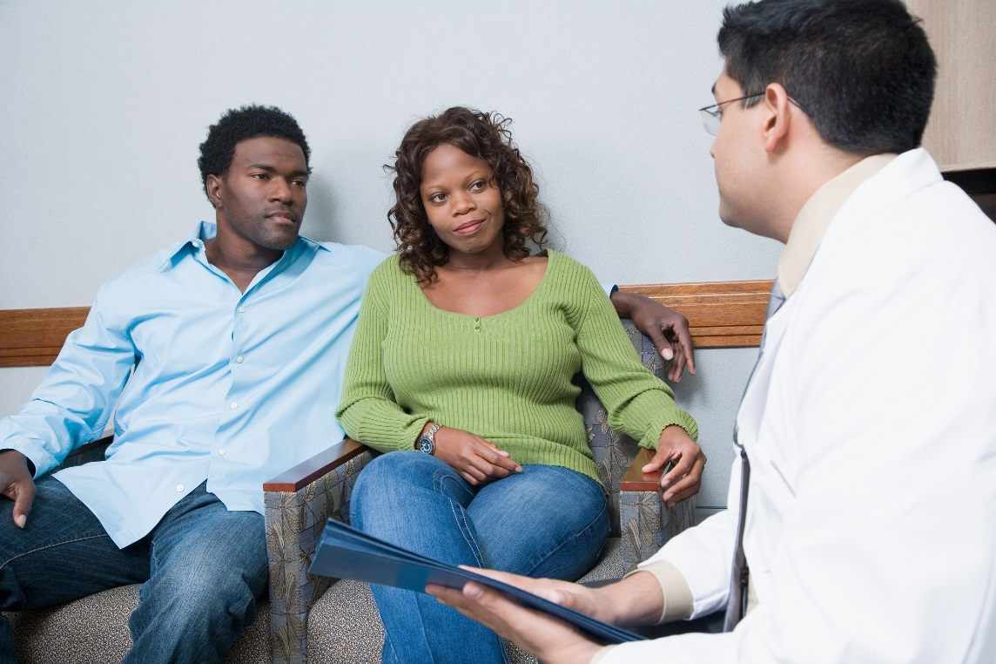

What is anal sex?
Anal sex is when a man puts his penis into his partner’s anus or rectum.
Notes:
This is not the same as when the penis is inserted into the vagina “from behind” or “from the back”.

Slide 3

Who has anal sex?
Although many people are embarrassed to talk about it, all kinds of people have anal sex

Slide 4

Both men and women have anal sex, regardless of their sexual orientation.
Who has anal sex?

Slide 5
Why might people have anal sex?

Slide 6
There are lots of reasons why people engage in anal sex, some of which include:
curiosity
pleasure
boredom
faster ejaculation
tighter sensation
to please a partner
money
during pregnancy or menstruation
as a form of contraception
to maintain ‘virginity’
to increase intimacy
any other reasons

Slide 7
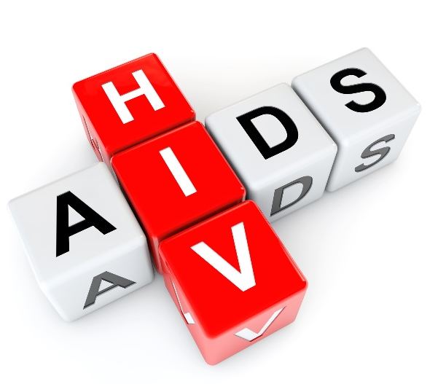
Can HIV be transmitted through anal sex?
Yes.
In fact, unprotected anal sex puts people at higher risk for acquiring HIV than any other sexual behavior.
Unprotected anal sex is riskier for women than unprotected vaginal sex when it comes to acquisition of HIV other STIs.

Slide 8
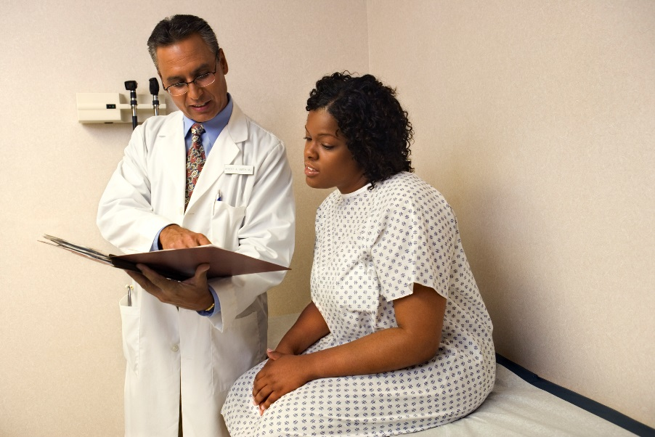
Why is unprotected anal sex so risky?
HIV can easily be transmitted through anal sex because tissue in the rectum is very delicate and lacks natural lubrication.
Rectal tissue is easily damaged during un-lubricated anal sex, providing an easy point of entry into the body for the HIV virus.

Slide 9

How can I protect myself from HIV during anal sex?

Slide 10
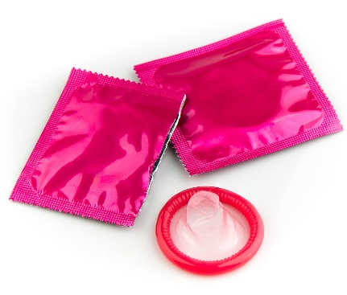
How can I protect myself from HIV during anal sex?
The best way to protect yourself from HIV while having anal sex is to use condoms and water-based lubricants (like KY jelly).
Oil-based lubricants (like Vaseline or body lotion) will damage condoms and should not be used.
Notes:
Other risk reduction options include reducing the number of sexual partners and replacing anal sex with less risky sexual behaviors.

Slide 11

It is unknown whether using a dapivirine ring vaginally offers protection from acquiring HIV through anal sex.
The ring should never be inserted rectally.
How can I protect myself from HIV during anal sex?

Slide 12
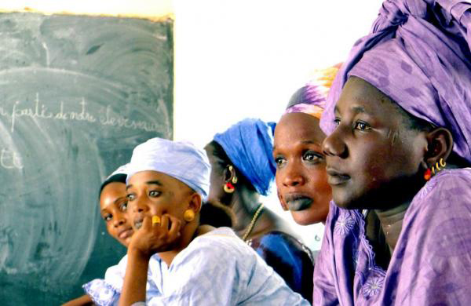
Why is it important to talk about anal sex in HOPE?

Slide 13
Why is it important to talk about anal sex in HOPE?
Many women and men are unaware that unprotected anal sex puts them at higher risk for HIV and other STIs.
Notes:
Study staff ask for open reporting of anal sex practices to make sure that participants have the information they need to protect themselves.
Study staff ask for open reporting of anal sex practices to make sure that participants have the information they need to protect themselves.
If a participant acquires HIV during the study, knowing about anal sex behaviors will help the research team understand if the infection could have been transmitted due to sexual practices that are not protected by vaginal ring use.

Slide 14


The study staff are here to help.
Study staff are available to inform and counsel study participants, their partners, and other community members about anal sex and any questions or concerns they may have, and will do so on a non-judgmental and professional way.
Notes:
There is another important fact about male circumcision that men and women should know.
In fact, a man is more likely to pass HIV to his partner during the time soon after circumcision, before his wound has healed.

Slide 15

If you have questions or need more information, please visit the study clinic.

